Slide 1
Chapter 15
Oscillatory Motion

Slide 2

Oscillatory Motion
Periodic motion
Spring-mass system
Differential equation of motion
Simple Harmonic Motion (SHM)
Energy of SHM
Pendulum
Torsional Pendulum

Slide 3
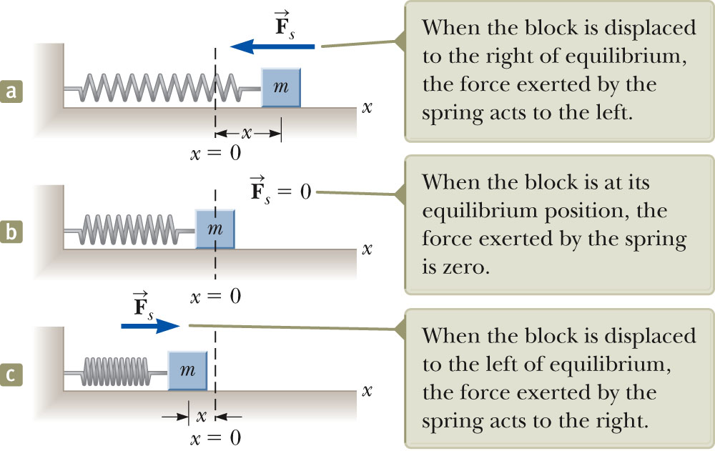
Periodic Motion
Periodic motion is a motion that regularly returns to a given position after a fixed time interval.
A particular type of periodic motion is “simple harmonic motion,” which arises when the force acting on an object is proportional to the position of the object about some equilibrium position.
The motion of an object connected to a spring is a good example.
Examples: The beating of your heart, the ticking of a clock, and the movement of a child on a swing.
The Earth returns to the same position in its orbit around the Sun each year.
In alternating-current electrical circuits, voltage, current, and electric charge vary periodically with time

Slide 4
Recall Hooke’s Law
Hooke’s Law states F_{s} = −kx
F_{s} is the restoring force.
It is always directed toward the equilibrium position.
Therefore, it is always opposite the displacement from equilibrium.
k is the force (spring) constant.
x is the displacement.
What is the restoring force for a surface water wave?

Slide 5
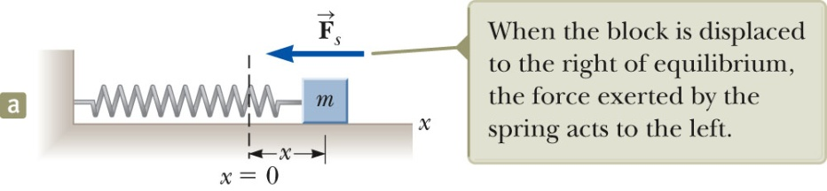
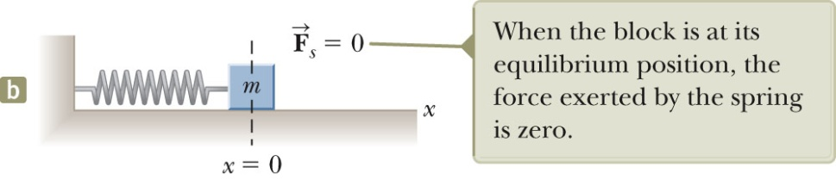
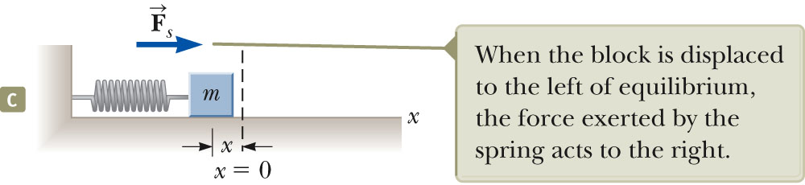
Restoring Force and the Spring Mass System
In a, the block is displaced to the right of x = 0.
The position is positive.
The restoring force is directed to
the left (negative).
In b, the block is at the equilibrium position.
x = 0
The spring is neither stretched nor compressed.
The force is 0.
In c, the block is displaced to the left of x = 0.
The position is negative.
The restoring force is directed to
the right (positive).

Slide 6
Differential Equation of Motion
Using F = ma for the spring, we have
But recall that acceleration is the second derivative of the position:
So this simple force equation is an example of a differential equation,
An object moves in simple harmonic motion whenever its acceleration is proportional to its position and has the opposite sign to the displacement from equilibrium.

Slide 7
Acceleration
Note that the acceleration is NOT constant, unlike our earlier kinematic equations.
If the block is released from some position x = A, then the initial acceleration is – kA/m, but as it passes through 0 the acceleration falls to zero.
It only continues past its equilibrium point because it now has momentum (and kinetic energy) that carries it on past x = 0.
The block continues to x = – A, where its acceleration then becomes +kA/m.

Slide 8
Analysis Model, Simple Harmonic Motion
What are the units of k/m, in ?
They are 1/s², which we can regard as a frequency-squared, so let’s write it as
Then the equation becomes
A typical way to solve such a differential equation is to simply search for a function that satisfies the requirement, in this case, that its second derivative yields the negative of itself! The sine and cosine functions meet these requirements.

Slide 9
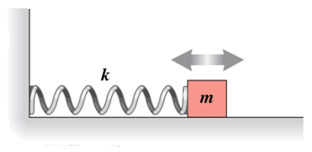
Mathematical Representation of Spring Mass System
As we know
Now Applying Hook’s Law
Let
Applying Newton’s second Law
Solution of differential equation

Slide 10

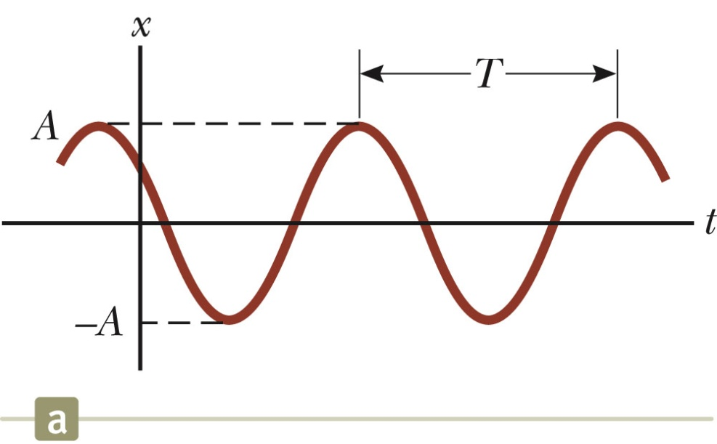
SHM Graphical Representation
A solution to the differential equation is
A, ω, φ are all constants:
A = amplitude (maximum position
in either positive or negative x direction,
ω = angular frequency,
φ = phase constant, or initial phase angle.
A and φ are determined by initial conditions.
Remember, the period
and frequency are:

Slide 11
Time Period and frequency of spring mass system
The period, T, of the motion is the time interval required for the particle to go through one full cycle of its motion.
The values of x and v for the particle at time t equal the values of x and v at t + T.
Time Period
After simplification
The frequency represents the number of oscillations the particle undergoes per unit time interval:
Frequency
Section 15.2

Slide 12
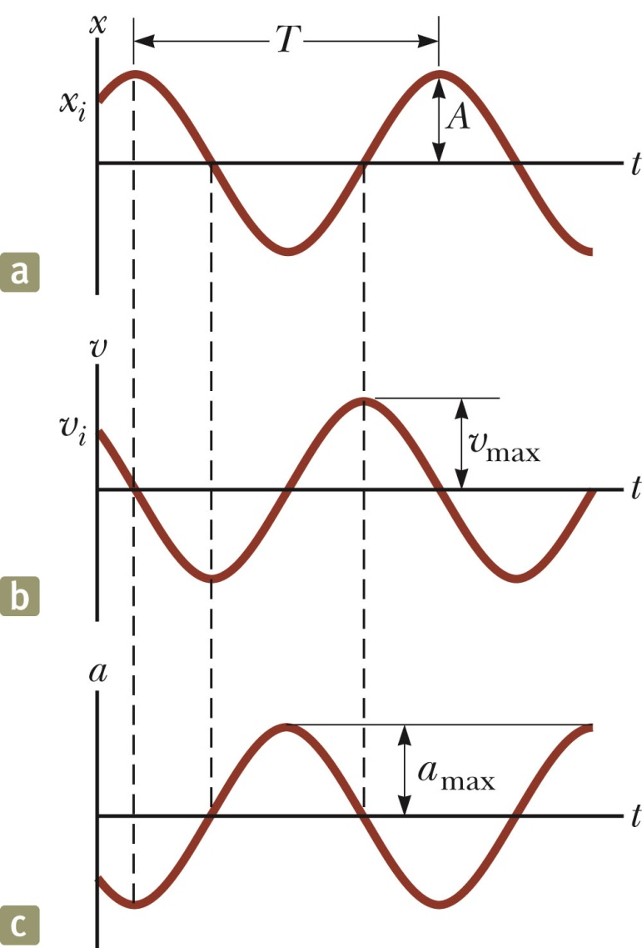
Motion Equations for SHM
The velocity is 90º out of phase with the displacement and the
acceleration is 180º out of phase with the displacement.

Slide 13
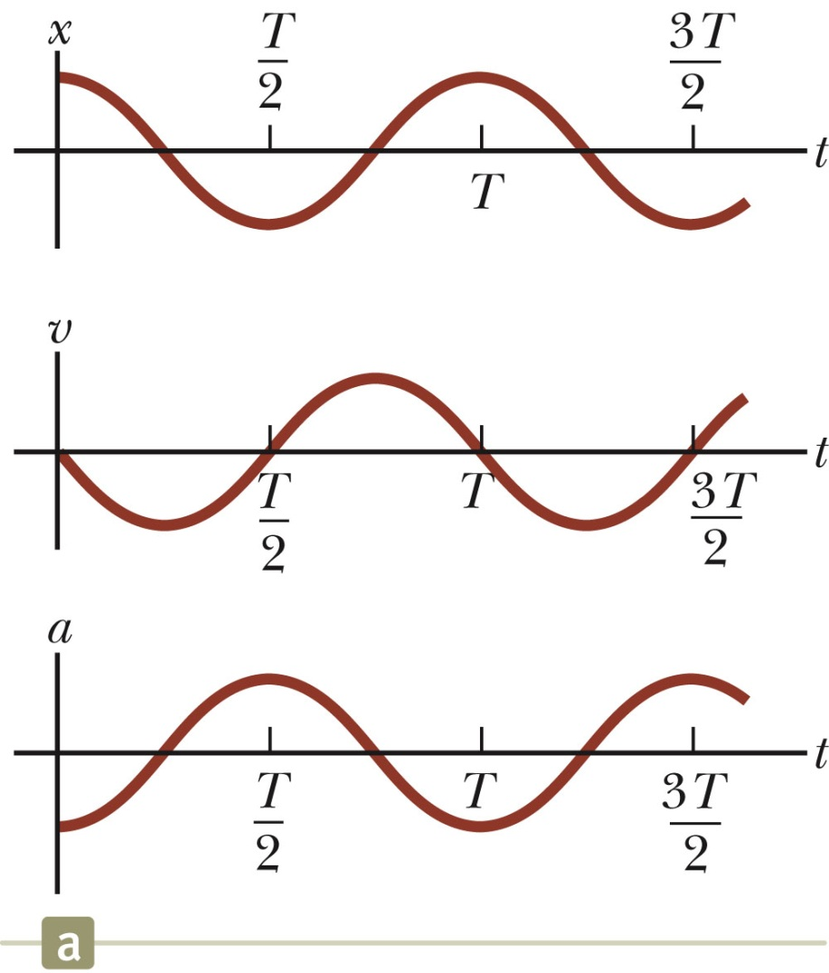
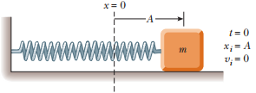
SHM Example 1
Initial conditions at t = 0 are
x (0)= A
v (0) = 0
This means φ = 0
The acceleration reaches extremes of ± w²A at ±A.
The velocity reaches extremes of ± wA at x = 0.

Slide 14
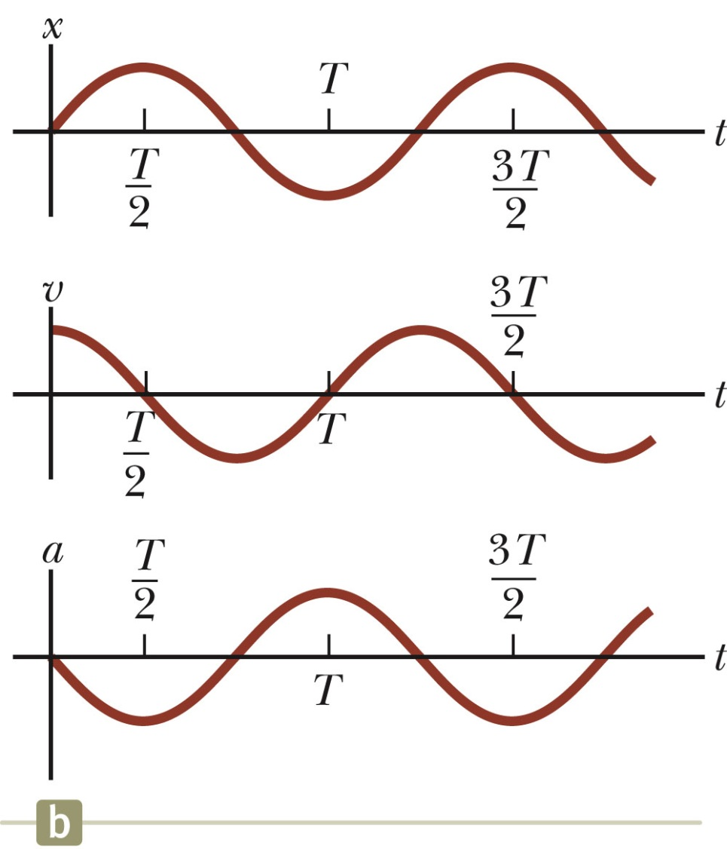
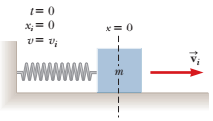
SHM Example 2
Initial conditions at t = 0 are
x (0)=0
v (0) = v_{i}
This means φ = - π / 2
The graph is shifted one-quarter cycle to the right compared to the graph of x (0) = A.
Section 15.2

Slide 15
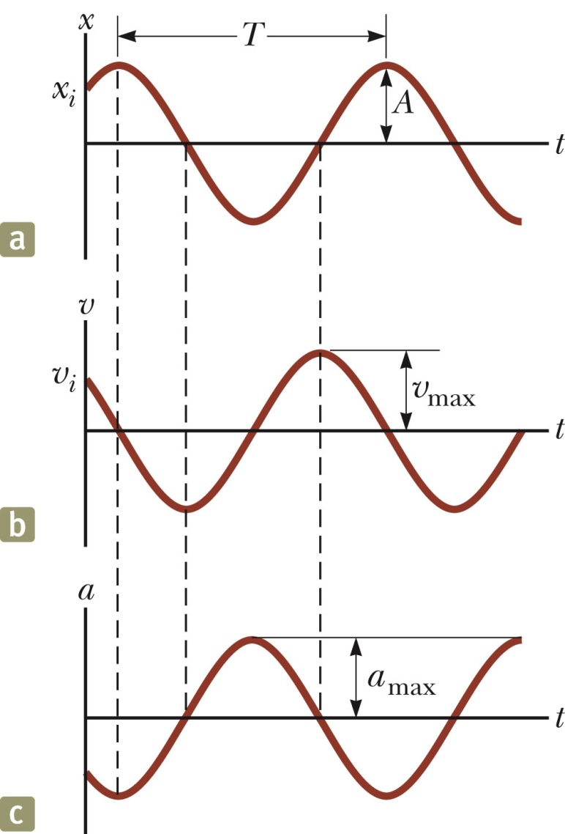
Maximum Values of v and a
Because the sine and cosine functions oscillate between ±1, we can easily find the maximum values of velocity and acceleration for an object in SHM.
Section 15.2

Slide 16
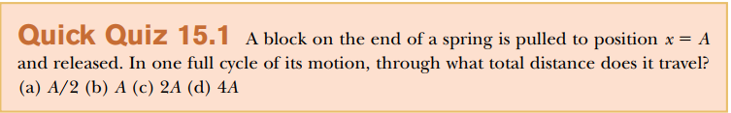
Quick Quiz

Slide 17
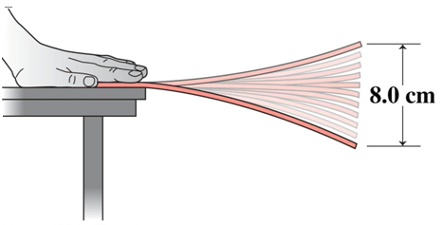
Problem. Oscillating Ruler
An oscillating ruler completes 28 cycles in 10 s & moves a total distance of 8.0 cm. What are the amplitude, period, & frequency of this oscillatory motion?
Amplitude = 8.0 cm / 2 = 4.0 cm.

Slide 18
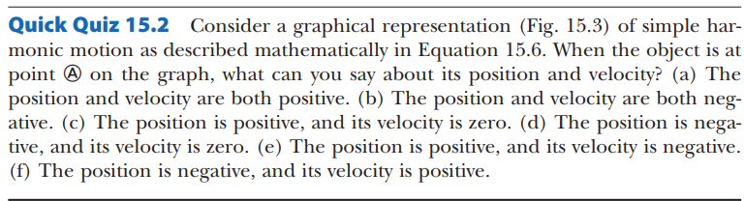
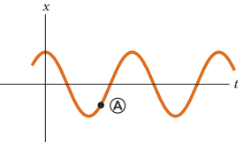
Figure:15.3

Slide 19
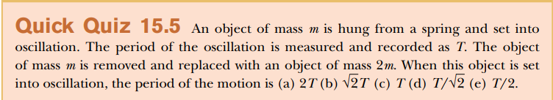

Slide 20








Frequency and Time Period in terms of system parameters

Slide 21
Problem 1:
An object oscillates with simple harmonic motion along the x axis. Its position varies with time according to the equation , where t is in seconds and the angles in the parentheses are in radians.
Determine the amplitude, frequency, and period of the motion.
Calculate the velocity and acceleration of the object at any time t.
Using the results of part (B), determine the position, velocity, and acceleration of the object at t = 1.00 s.
Determine the maximum speed and maximum acceleration of the object.
Find the displacement of the object between t = 0 and t = 1.00 s

Slide 22
Problem 1: Determine the amplitude, frequency, and period of the motion.
Solution: Given
Amplitude: A = 4 m

Slide 23
(B) Calculate the velocity and acceleration of the object at any time t.
Solution:

Slide 24
(C) Using the results of part (B), determine the position, velocity, and acceleration of the object at t = 1.00 s.
Solution:
At t= 1.00 s

Slide 25
(D) Determine the maximum speed and maximum acceleration of the object.
Solution:

Slide 26
(E) Find the displacement of the object between t = 0 and t = 1.00 s
Solution:
The position at t = 0 s
In part C we found that the position at t = 1s, is -2.83 m

Slide 27
Problem 2:
A car with a mass of 1 300 kg is constructed so that its frame is supported by four springs. Each spring has a force constant of 20 000 N/m. If two people riding in the car have a combined mass of 160 kg, find the frequency of vibration of the car after it is driven over a pothole in the road Solution:
What if? Suppose the two people exit the car on the side of the road. One of them pushes downward on the car and release it so that it oscillates vertically. Is the frequency of the oscillation the same as the value we just calculated?

Slide 28
Problem: 3
A 200-g block connected to a light spring for which the force constant is 5.00 N/m is free to oscillate on a horizontal, frictionless surface. The block is displaced 5.00 cm from equilibrium and released from rest.
Find the period of its motion.
Determine the maximum speed of the block.
What is the maximum acceleration of the block?
Express the position, speed, and acceleration as functions of time.
What If? What if the block is released from the same initial position, x_{i} = 5.00 cm, but with an initial velocity of v_{i} = 0.100 m/s? Which parts of the solution change and what are the new answers for those that do change?

Slide 29
Problem 3: Solution
(c) What is the maximum acceleration of the block?
Find the period of it motion?
(b) Determine the maximum speed of the block?

Slide 30
(D) Express the position, speed and acceleration as function of time?
Problem 3: Solution
First we will find phase constant from the initial condition that x = A at t = 0:

Slide 31
What If? What if the block is released from the same initial position, x_{i} = 5.00 cm, but with an initial velocity of v_{i} = 0.100 m/s? Which parts of the solution change and what are the new answers for those that do change?
Problem 3: Solution
Answers Part (A) does not change because the period is independent of how the oscillator is set into motion. Parts (B), (C), and (D) will change

Slide 32

Problem 3: Solution

Slide 33
Problem: Tuned Mass Damper
The tuned mass damper in New York’s Citicorp Tower consists of a 373x10³ kg concrete block that completes one cycle of oscillation in 6.80 s. The oscillation amplitude in a high wind is 110 cm. Determine the spring constant & the maximum speed & acceleration of the block.
→

Slide 34
Energy of the SHM Oscillator
Mechanical energy is associated with a system in which a particle undergoes simple harmonic motion.
For example, assume a spring-mass system is moving on a frictionless surface.
Because the surface is frictionless, the system is isolated.
This tells us the total energy is constant.
The kinetic energy can be found by
K = ½ mv ² = ½ mω² A² sin² (ωt + φ)
Assume a massless spring, so the mass is the mass of the block only.
The elastic potential energy can be found by
U = ½ kx ² = ½ kA² cos² (ωt + φ)
Section 15.3

Slide 35
Energy of the SHM Oscillator
The kinetic energy
And Potential energy
The total energy

Slide 36
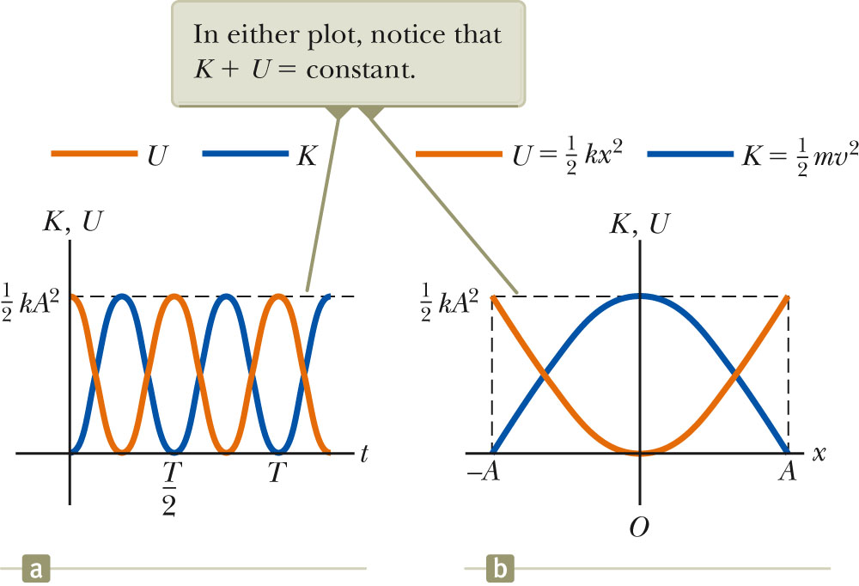
Energy of the SHM Oscillator, cont.
The total mechanical energy is constant.
At all times, the total energy is
½ k A²
The total mechanical energy is proportional to the square of the amplitude.
Energy is continuously being transferred between potential energy stored in the spring and the kinetic energy of the block.
In the diagram, Φ = 0
.
Section 15.3

Slide 37
Energy of the SHM Oscillator, final
Variations of K and U can also be observed with respect to position.
The energy is continually being transformed between potential energy stored in the spring and the kinetic energy of the block.
The total energy remains the same
E = ½ k A²
Section 15.3

Slide 38
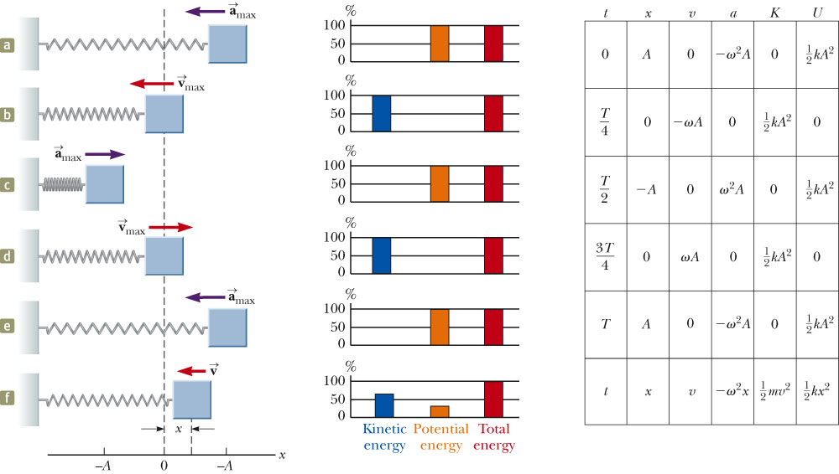
Energy in SHM, summary
Section 15.3

Slide 39
Velocity at a Given Position
Energy can be used to find the velocity:
Section 15.3

Slide 40


Problem 15.4:
A 0.500-kg cart connected to a light spring for which the force constant is 20.0 N/m oscillates on a horizontal, frictionless air track. (A) Calculate the total energy of the system and the maximum speed of the cart if the amplitude of the motion is 3.00 cm
(B) What is the velocity of the cart when the position is 2.00 cm?
(C) Compute the kinetic and potential energies of the system when the position is 2.00 cm. Solution:

Slide 41
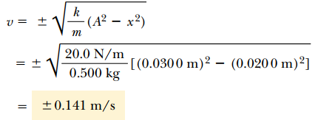
Problem 15.4:
A 0.500-kg cart connected to a light spring for which the force constant is 20.0 N/m oscillates on a horizontal, frictionless air track. (B) What is the velocity of the cart when the position is 2.00 cm?
(C) Compute the kinetic and potential energies of the system when the position is 2.00 cm. Solution:

Slide 42


Problem 15.4:
A 0.500-kg cart connected to a light spring for which the force constant is 20.0 N/m oscillates on a horizontal, frictionless air track. (C) Compute the kinetic and potential energies of the system when the position is 2.00 cm. Solution:

Slide 43
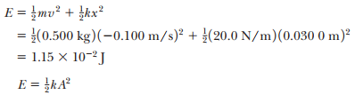
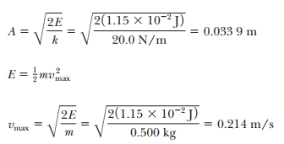
Problem 15.4:
The cart in this example could have been set into motion by releasing the cart from rest at x = 3.00 cm. What if the cart were released from the same position, but with an initial velocity of v = -0.100 m/s? What are the new amplitude and maximum speed of the cart? Solution:

Slide 44
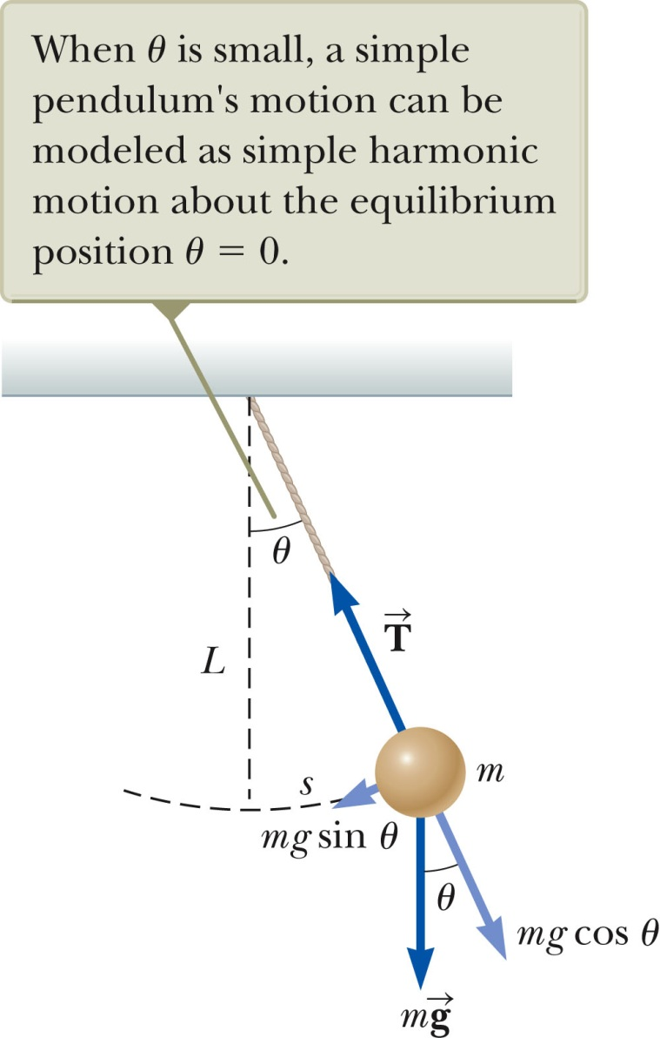
Simple Pendulum
The simple pendulum is another mechanical system that exhibits periodic motion. It consists of a particle-like bob of mass m suspended by a light string of length L.
The motion occurs in the vertical plane and is driven by gravitational force.
The motion is very close to that of the SHM oscillator.
If the angle is <10º
Section 15.5

Slide 45
Simple Pendulum, 2
The forces acting on the bob are the tension and the weight.
is the force exerted on the bob by the string.
is the gravitational force.
The tangential component of the gravitational force is a restoring force.
Section 15.5

Slide 46
Simple Pendulum, 3
In the tangential direction,
The length, L, of the pendulum is constant, and for small
values of θ.
This confirms the mathematical form of the motion is the same as for SHM.
Section 15.5

Slide 47
Simple Pendulum
The function θ can be written as θ = θ_{max} cos (ωt + φ).
The angular frequency is
The period is
Section 15.5

Slide 48
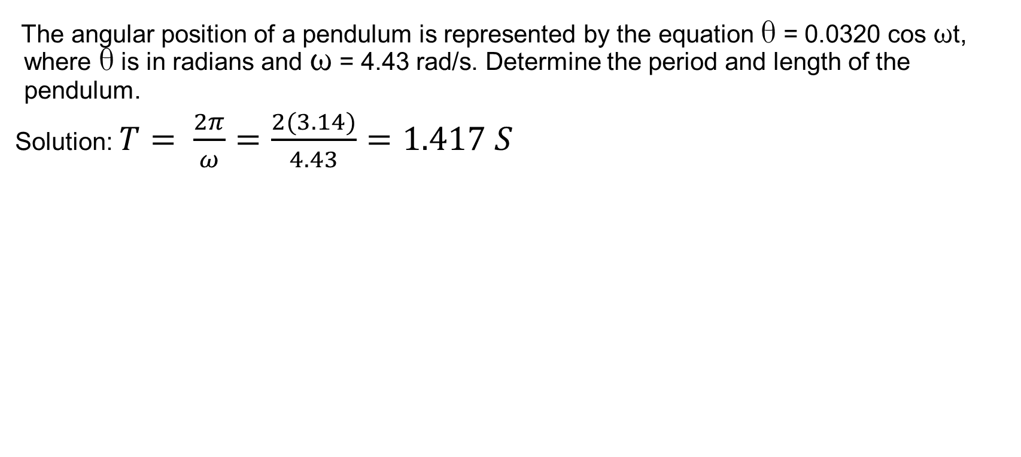
Problem 39:
The angular position of a pendulum is represented by the equation θ = 0.0320 cos ωt, where θ is in radians and ω = 4.43 rad/s. Determine the period and length of the pendulum.
Solution: $T= \frac{2π}{ω}=\frac{2(3.14)}{4.43}=1.417 S$

Slide 49
Simple Pendulum Summary
The period and frequency of a simple pendulum depend only on the length of the string and the acceleration due to gravity.
The period is independent of the mass.
All simple pendula that are of equal length and are at the same location oscillate with the same period.
Section 15.5

Slide 50
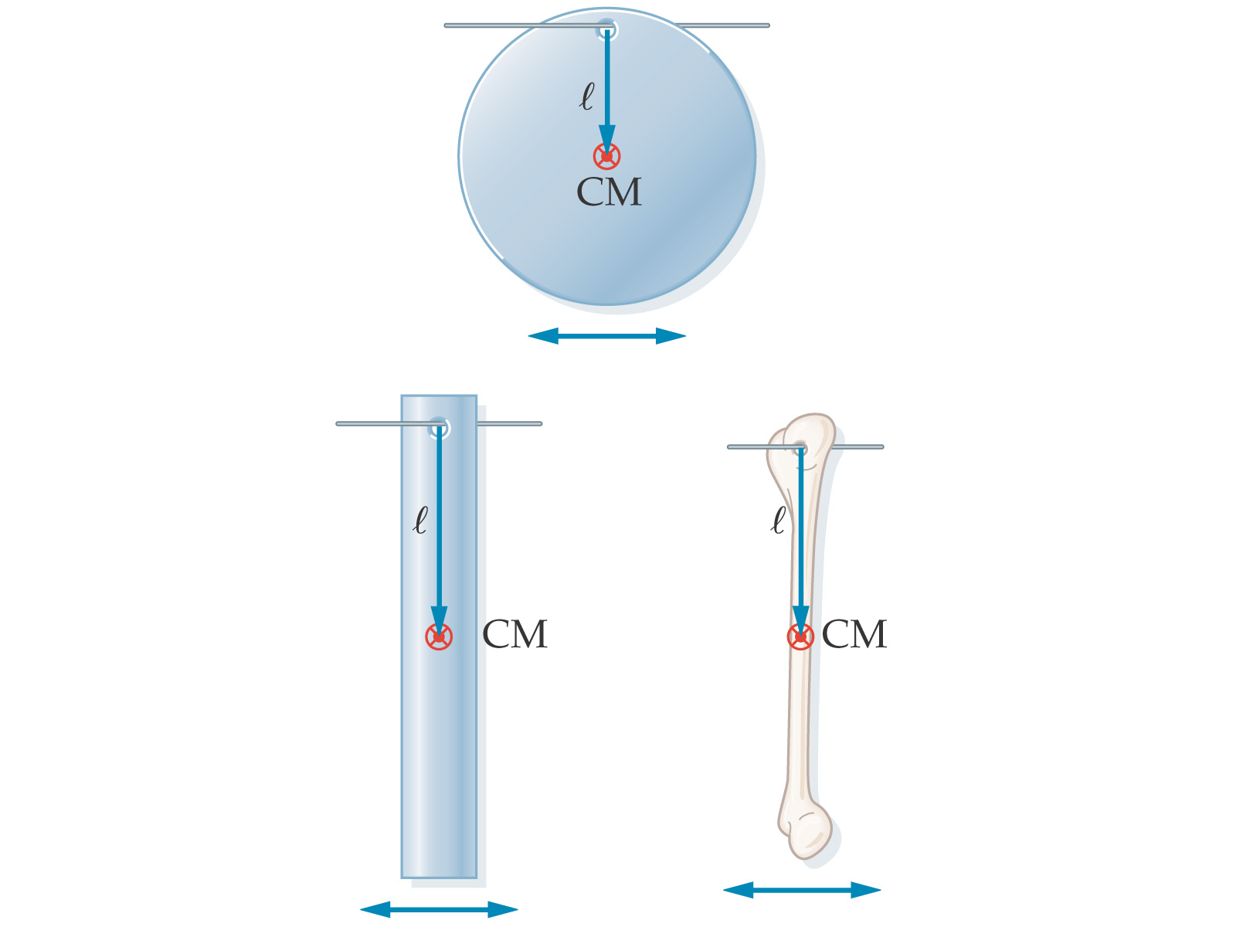
Physical Pendulum
A physical pendulum is a solid mass that oscillates around its center of mass, but cannot be modeled as a point mass suspended by a massless string. Examples:

Slide 51
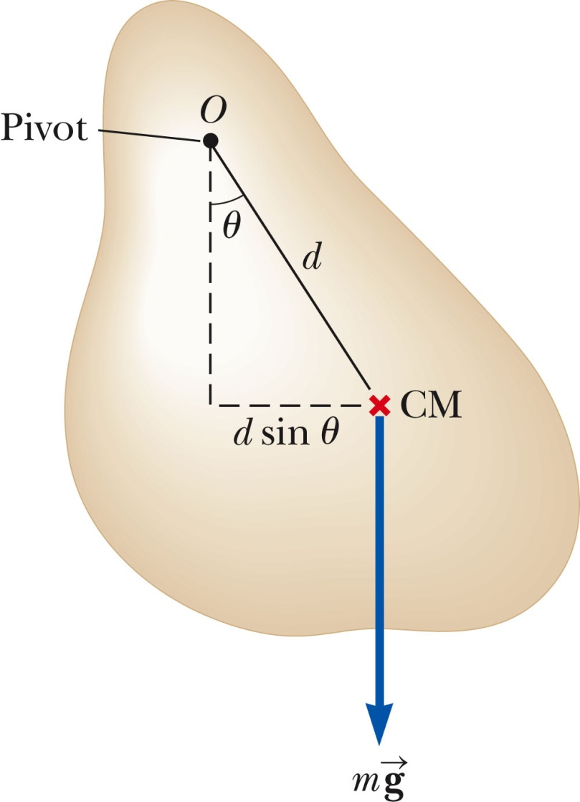
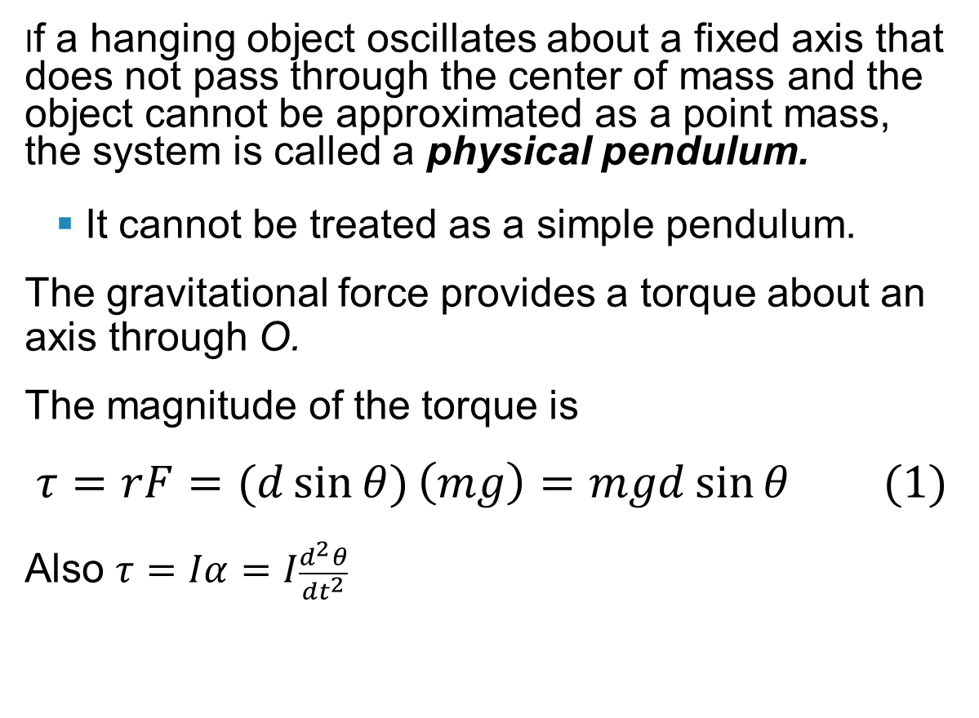
Physical Pendulum
Section 15.5

Slide 52
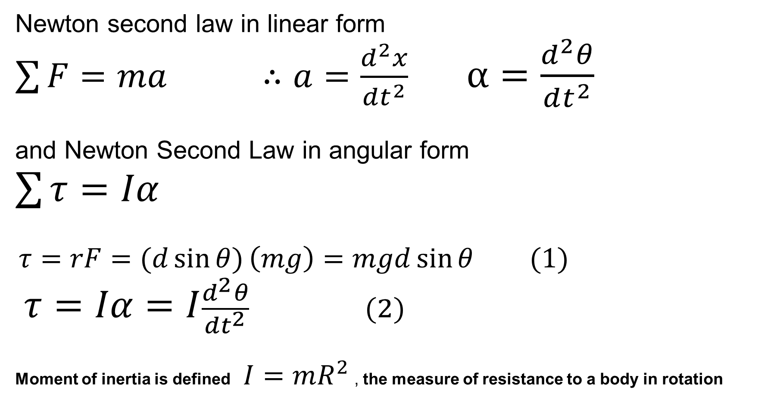
Torque, Moment of Inertia and Newton’s Law

Slide 53
Physical Pendulum
I is the moment of inertia about the axis through O.
From Newton’s Second Law,
The gravitational force produces a restoring force.
Assuming θ is small, this becomes
Section 15.5

Slide 54
Physical Pendulum
This equation is of the same mathematical form as an object in simple harmonic motion.
The solution is that of the simple harmonic oscillator.
The angular frequency is
The period is
Section 15.5

Slide 55
Physical Pendulum
A physical pendulum can be used to measure the moment of inertia of a flat rigid object.
If you know d, you can find I by measuring the period.
If I = m d² then the physical pendulum is the same as a simple pendulum.
The mass is all concentrated at the center of mass.
Section 15.5

Slide 56
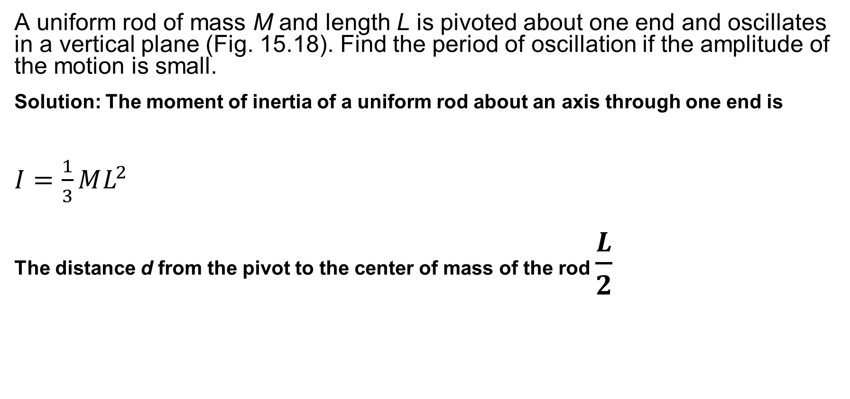
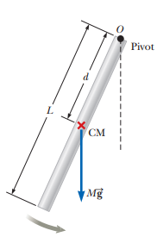

Problem 15.6:

Slide 57
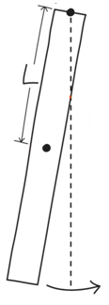
Problem. Walking
When walking, the leg not in contact of the ground swings forward,
acting like a physical pendulum.
Approximating the leg as a uniform rod, find the period for a leg 90 cm long.
Table 10.2
Forward stride = T/2 = 0.8 s

Slide 58
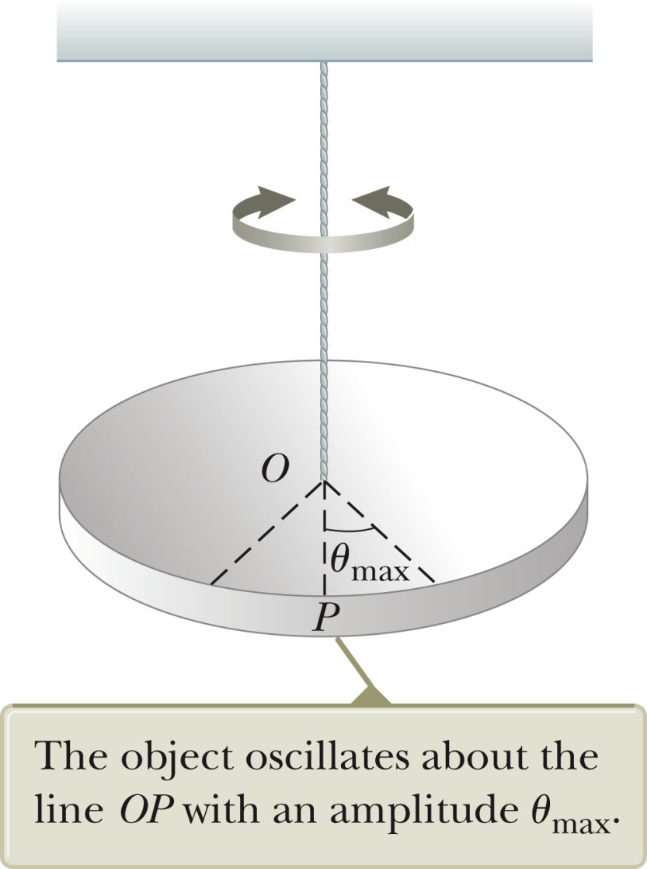
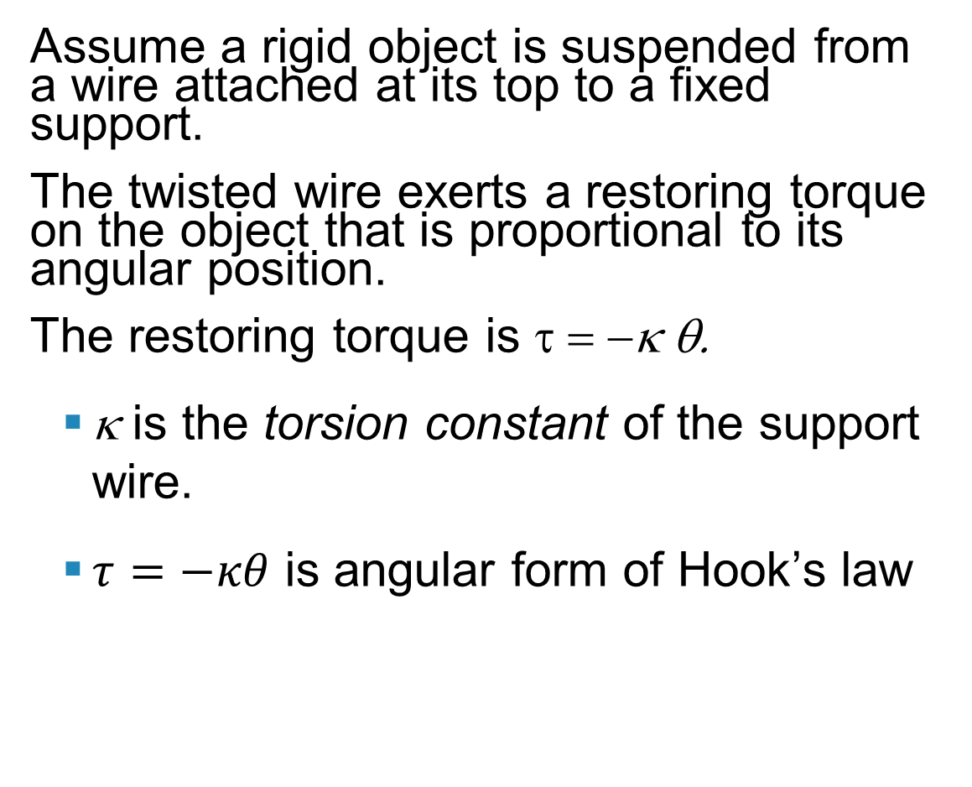
Torsional Pendulum
Assume a rigid object is suspended from a wire attached at its top to a fixed support.
The twisted wire exerts a restoring torque on the object that is proportional to its angular position.
The restoring torque is τ = −κ θ.
κ is the torsion constant of the support wire.
$τ=−κθ$ is angular form of Hook’s law
Section 15.5

Slide 59
Torsional Pendulum
Newton’s Second Law gives
The torque equation produces a motion equation for simple harmonic motion.
The angular frequency is
The period is
No small-angle restriction is necessary.
Assumes the elastic limit of the wire is not exceeded

Slide 60
Damped Oscillations
In many real systems, non-conservative forces are present.
This is no longer an ideal system (the type we have dealt with so far).
Friction and air resistance are common non-conservative forces.
In this case, the mechanical energy of the system diminishes in time, the motion is said to be damped.
Section 15.6

Slide 61
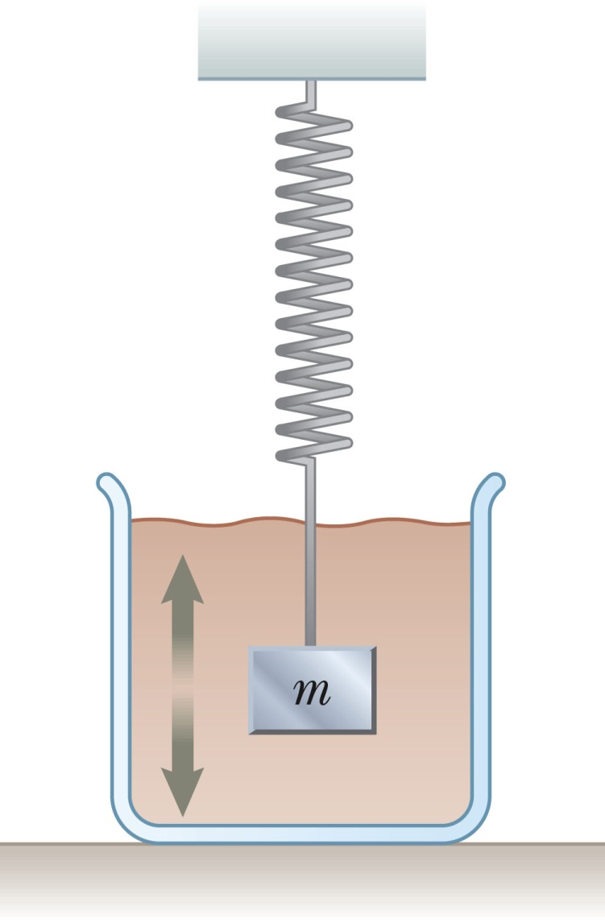
Damped Oscillation, Example
One example of damped motion occurs when an object is attached to a spring and submerged in a viscous liquid.
The retarding force can be expressed as
b is a constant
b is called the damping coefficient
Section 15.6

Slide 62
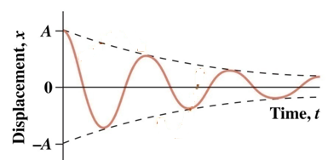
Damped Harmonic Motion
sinusoidal oscillation
Damping (frictional) force:
Damped mass-spring:
Amplitude exponential decay
Ansatz:
→
∴

Slide 63
Damped Oscillations, Equations
From Newton’s Second Law
ΣF_{x} = -k x – bv_{x} = ma_{x}
When the retarding force is small compared to the maximum restoring force we can determine the expression for x.
This occurs when b is small.
The position can be described by
The angular frequency will be
Section 15.6

Slide 64
Damped Oscillations, Natural Frequency
When the retarding force is small, the oscillatory character of the motion is preserved, but the amplitude decreases exponentially with time.
The motion ultimately ceases.
Another form for the angular frequency:
where ω₀ is the angular frequency in the absence of the retarding force and is called the natural frequency of the system.
Section 15.6

Slide 65
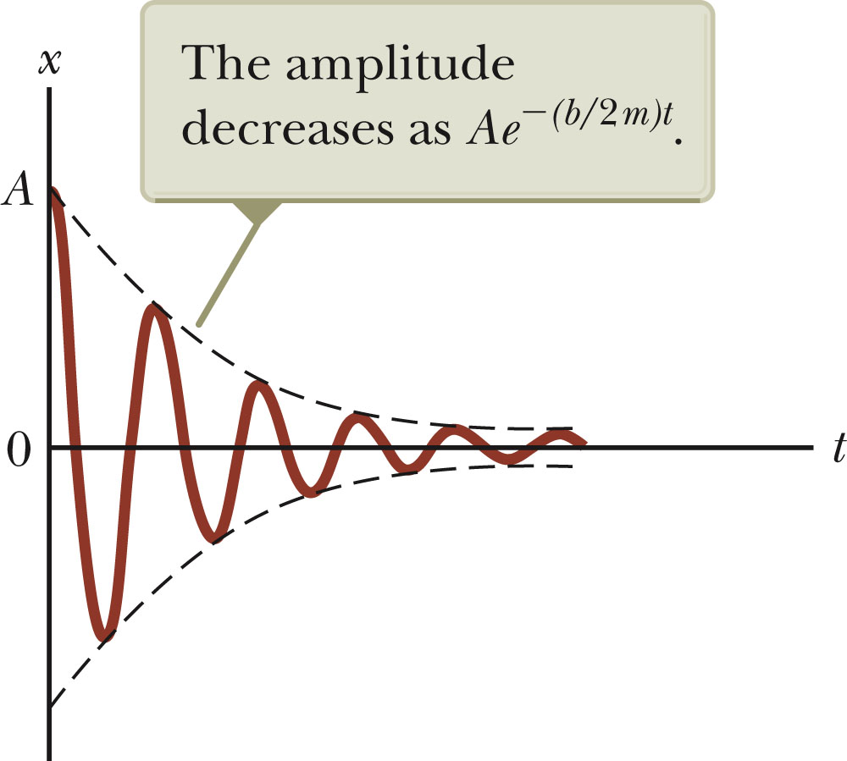
Damped Oscillations, Graph
A graph for a damped oscillation.
The amplitude decreases with time.
The blue dashed lines represent the envelope of the motion.
Use the active figure to vary the mass and the damping constant and observe the effect on the damped motion.
The restoring force is – kx.
Section 15.6

Slide 66
Types of Damping
If the restoring force is such that b/2m < ω_{o}, the system is said to be underdamped.
When b reaches a critical value b_{c} such that b_{c} / 2 m = ω₀ , the system will not oscillate.
The system is said to be critically damped.
If the restoring force is such that b/2m > ω_{o}, the system is said to be overdamped.
Section 15.6

Slide 67
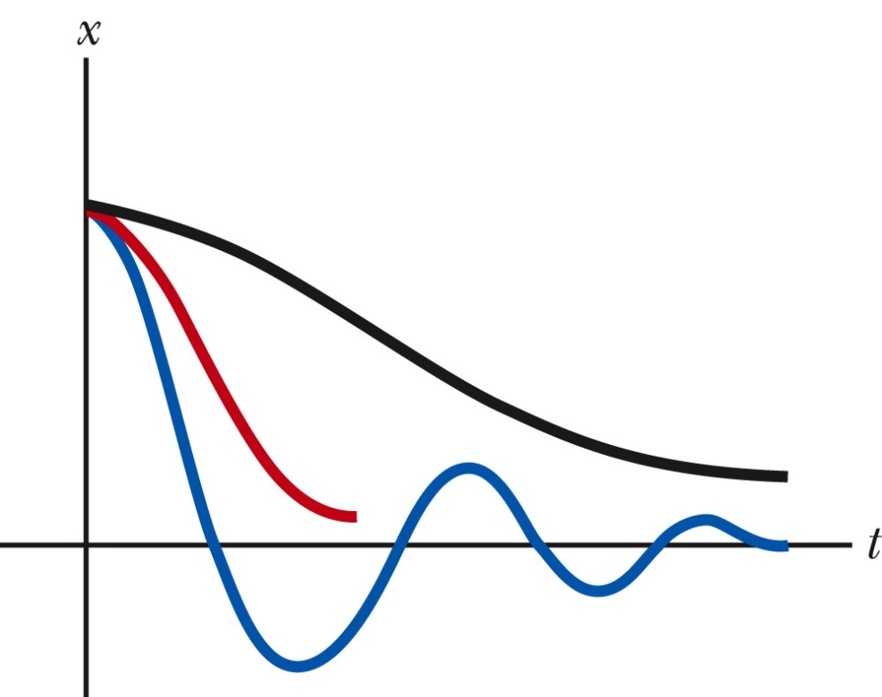
Types of Damping, cont
Graphs of position versus time for
An underdamped oscillator – blue
A critically damped oscillator – red
An overdamped oscillator – black
For critically damped and overdamped there is no angular frequency.
Section 15.6

Slide 68
Forced Oscillations
It is possible to compensate for the loss of energy in a damped system by applying a periodic external force.
The amplitude of the motion remains constant if the energy input per cycle exactly equals the decrease in mechanical energy in each cycle that results from resistive forces.
After a driving force on an initially stationary object begins to act, the amplitude of the oscillation will increase.
After a sufficiently long period of time, E_{driving} = E_{lost to internal}
Then a steady-state condition is reached.
The oscillations will proceed with constant amplitude.
Section 15.7

Slide 69
Forced Oscillations, cont.
The amplitude of a driven oscillation is
ω₀ is the natural frequency of the undamped oscillator.
Section 15.7

Slide 70
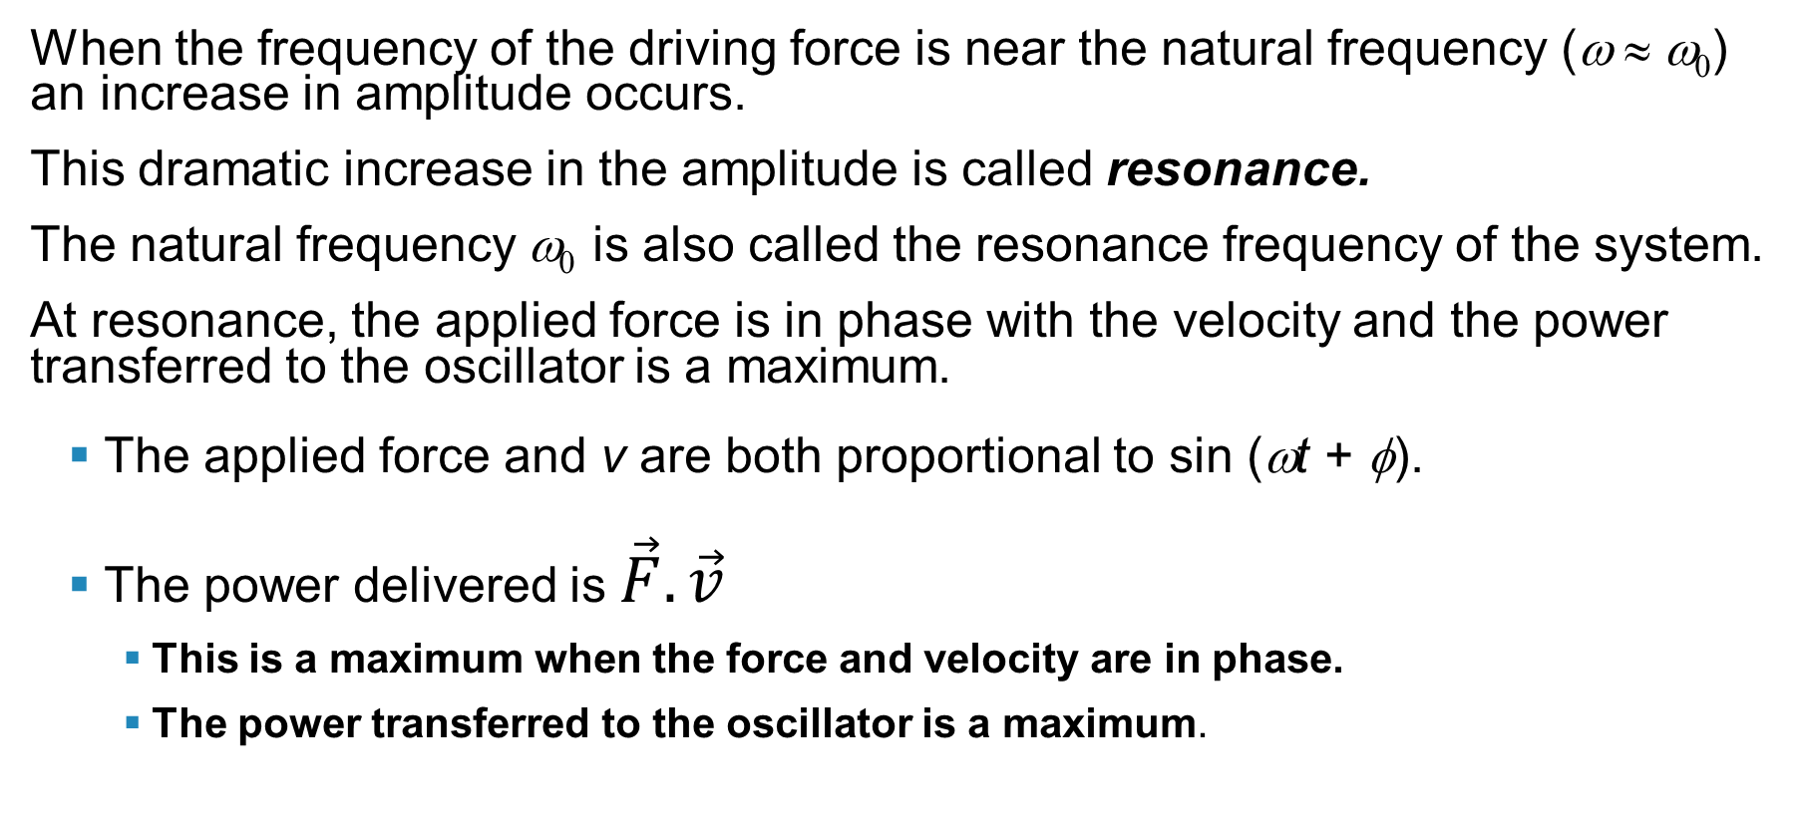
Resonance
When the frequency of the driving force is near the natural frequency (ω ≈ ω₀) an increase in amplitude occurs.
This dramatic increase in the amplitude is called resonance.
The natural frequency ω₀ is also called the resonance frequency of the system.
At resonance, the applied force is in phase with the velocity and the power transferred to the oscillator is a maximum.
The applied force and v are both proportional to sin (ωt + φ).
The power delivered is $\vec{F}.\vec{v}$
This is a maximum when the force and velocity are in phase.
The power transferred to the oscillator is a maximum.
Section 15.7

Slide 71
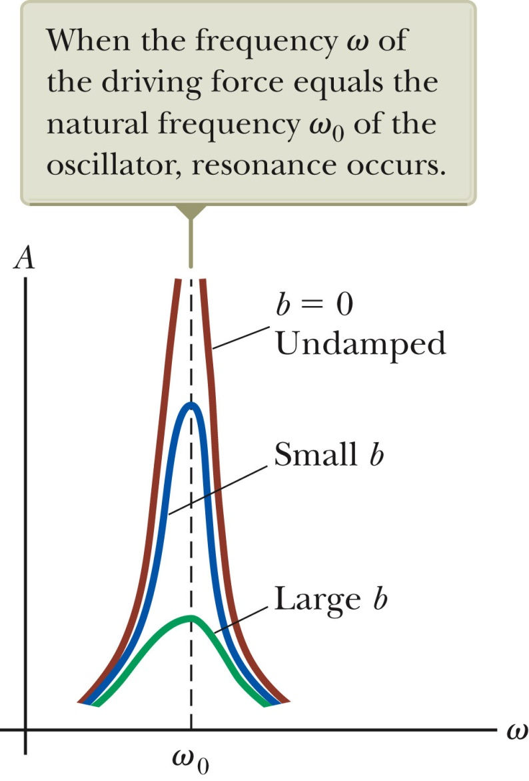
Resonance, cont.
Resonance (maximum peak) occurs when driving frequency equals the natural frequency.
The amplitude increases with decreased damping.
The curve broadens as the damping increases.
The shape of the resonance curve depends on b.
Section 15.7

Slide 72
Practice Problem: 1
A 50-g mass is attached to a spring and undergoes simple harmonic motion. Its maximum acceleration is 15 m/s² and its maximum speed is 3.5 m/s.
Determine the (a) angular frequency, (b) spring constant, and (c) amplitude.

Slide 73
Practice Problem: 2
A 2.00-kg object is attached to a spring and placed on a frictionless, horizontal surface. A horizontal force of 20.0 N is required to hold the object at rest when it is pulled to x = 0.200 m from its equilibrium position (at x = 0), and then released from rest and it subsequently undergoes simple harmonic oscillations.
(a) Find the force constant of the spring, k, and the frequency of the oscillations, ƒ.
(b) Calculate the maximum speed of the object, v_{max}. Where does this maximum speed occur?
(c) Find the maximum acceleration of the object, a_{max.} Where does the maximum acceleration occur?
(d) Calculate the total energy of the oscillating system.
(e) Determine the speed and the acceleration of the object when its position is equal to one-third the maximum value,
(f) Express the position, velocity, and acceleration as functions of time,
x(t), v(t), a(t)
.

Slide 74
Practice Problem: 3
A particle moving along the x axis in simple harmonic motion starts from its equilibrium position, the origin, at t = 0 sec and moves to the right. The amplitude of its motion is A = 2.00 cm, and the frequency is ƒ = 1.50 Hz.
(a) Find an expression for the position of the particle as a function of time.
(b) Determine the maximum speed and maximum positive acceleration of the particle.
(c) Find the total distance traveled by the particle between t = 0 and t = 1.00 s.

Slide 75
Practice Problem
4. What is the period of 60.0 Hz electrical power?
5. If your heart rate is 150 beats per minute during strenuous exercise, what is the time per beat in units of seconds?
6. Find the frequency of a tuning fork that takes 2.50×10⁻³ s to complete one oscillation.
7. A stroboscope is set to flash every 8.00×10⁻⁵s. What is the frequency of the flashes?
8. (a) What is the maximum velocity of an 85.0-kg person bouncing on a bathroom scale having a force constant of 1.50×10⁶ N/m, if the amplitude of the bounce is 0.200 cm? (b)What is the maximum energy stored in the spring?

Slide 76
Practice Problem:9
Consider a spring that is standing on end in the vertical position. You place 100 grams on the spring and it compresses a distance of 9.8 cm.
If an additional 200 grams are placed on top of the 100 gram mass, how much will the spring compress?
What is the spring constant?

Slide 77
Practice Problem:10
A spring is hanging freely from the ceiling. You attach an object to the end of the spring and let the object go. It falls down a distance 49 cm and comes back up to where it started. It continues to oscillate in simple harmonic motion going up and down a total distance of 49 cm from top to bottom. What is the period of the simple harmonic motion?

Slide 78
Practice Problem
11) A 1.50-kg object on a frictionless horizontal surface oscillates at the end of a spring (force constant k = 500 N/m ). The object’s maximum speed is 70.0 cm/s (a) What is the system’s total mechanical energy? (b) What is the amplitude of the motion?
12) A 3.0-kg object on a frictionless horizontal surface oscillates at the end of a spring with an amplitude of 8.0 cm. Its maximum acceleration is 3.5 m/s². Find the total mechanical energy.
13) You are given a meterstick and asked to drill a small diameter hole through it so that, when the stick is pivoted about a horizontal axis through the hole, the period of the pendulum will be a minimum. Where should you drill the hole?
14) A 450-g mass on a spring is oscillating at 1.2 Hz, with total energy 0.51 J. What’s the oscillation amplitude?

Slide 79
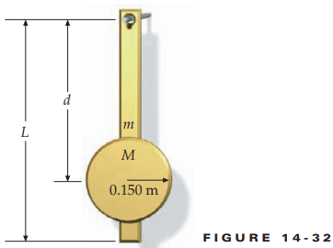
Practice Problem: 15
Figure 14-32 shows the pendulum of a clock in your grandmother’s house. The uniform rod of length L = 2.00 m has a mass m = 0.800 kg. Attached to the rod is a uniform disk of mass M = 1.20 kg and radius 0.150 m. The clock is constructed to keep perfect time if the period of the pendulum is exactly 3.50 s. (a) What should the distance d be so that the period of this pendulum is 2.50 s?
(b) Suppose that the pendulum clock loses 5.00 min/d. To make sure your grandmother will not be late for her quilting parties, you decide to adjust the clock back to its proper period. How far and in what direction should you move the disk to ensure that the clock will keep perfect time?.

Slide 80
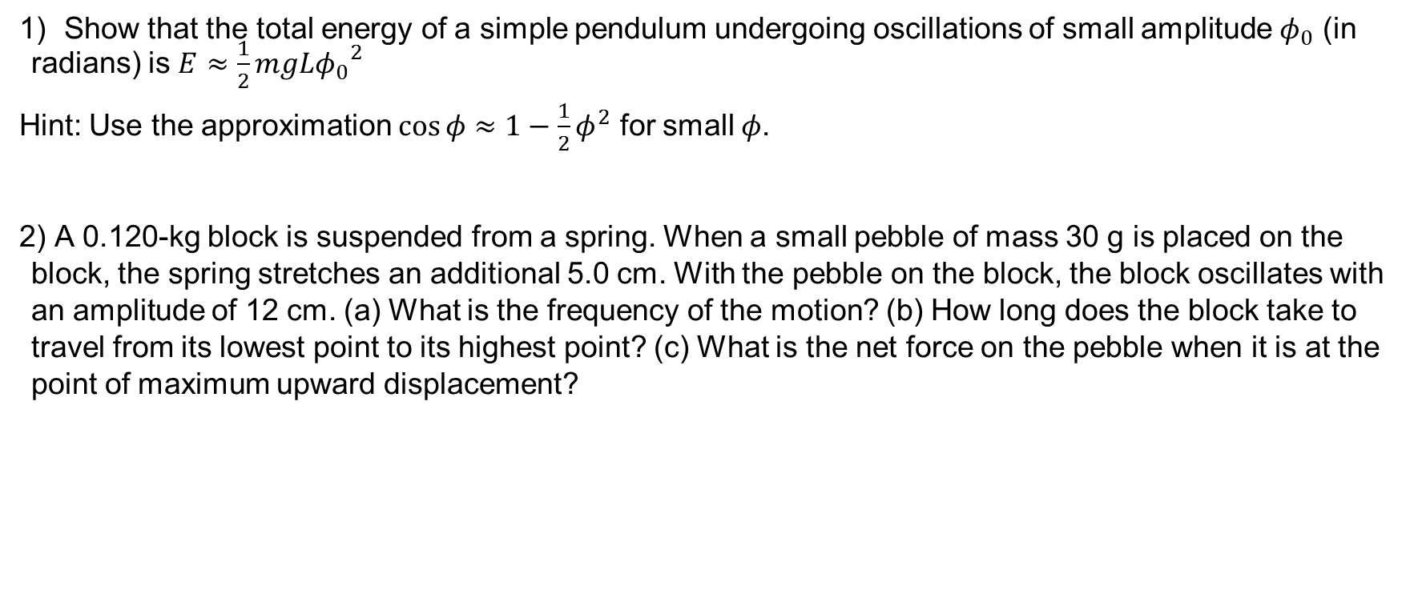
Practice Problem:16
Show that the total energy of a simple pendulum undergoing oscillations of small amplitude $φ_{0}$ (in radians) is $E≈\frac{1}{2}mgL{φ_{0}}^{2}$
Hint: Use the approximation $\cos{φ≈1−\frac{1}{2}φ^{2}}$ for small $φ$.
2) A 0.120-kg block is suspended from a spring. When a small pebble of mass 30 g is placed on the block, the spring stretches an additional 5.0 cm. With the pebble on the block, the block oscillates with an amplitude of 12 cm. (a) What is the frequency of the motion? (b) How long does the block take to travel from its lowest point to its highest point? (c) What is the net force on the pebble when it is at the point of maximum upward displacement?

